Slide 1
Module 3: Individual Peacekeeping Personnel
Lesson
3.6
Safety and Security for UN Personnel

Slide 2
Relevance
Dangerous and life-threatening situations
UN measures in place
UN Core Pre-Deployment Training Materials 2017

Slide 3
Learning Outcomes
Learners will:
List the categories of threats to the UN
Explain who is responsible for the safety and security of UN personnel
Describe the Security Levels System (SLS)
Explain security clearance procedures for travel
UN Core Pre-Deployment Training Materials 2017

Slide 4
Lesson Overview
Definitions
Categories of Threats to the UN
Responsibility for UN Safety & Security
UNSMS
SRM
SLS
Security Plan
MOSS & MORSS
TRIP
What Individual Peacekeeping Personnel Can Do
UN Core Pre-Deployment Training Materials 2017

Slide 5
Learning Activity
3.6.1
Film: Challenges in the Field
Instructions:
What threats are faced by UN personnel?
Discuss ways to protect the safety and security of UN personnel and its premises in the field
Time: 10 minutes
Film: 4:39 minutes
Group work: 5 minutes
https://youtu.be/OyJULAN7-so
UN Core Pre-Deployment Training Materials 2017
Notes:
CPTM 3.5.2

Slide 6
1. Definitions
Safety: protection against accidental events
Security: protection against intentional damages
Threat: a person or thing which causes harm
Vulnerability: a weakness which makes one susceptible to harm
Risk: the likelihood of a threat occurring as a result of vulnerabilities
UN Core Pre-Deployment Training Materials 2017

Slide 7
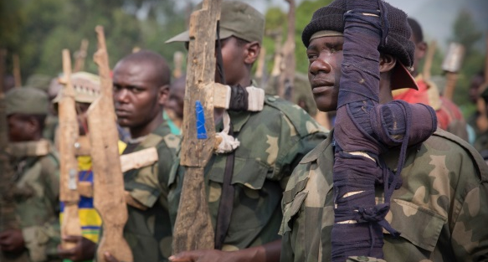
2. Categories of Threats to the UN
Armed Conflict
Terrorism
Crime
Civil Unrest
Hazards
UN Core Pre-Deployment Training Materials 2017

Slide 8
3. Responsibility for UN Safety & Security
Host government – primary responsibility
United Nations Security Management System (UNSMS) – to reinforce and supplement
You are also responsible
UN Core Pre-Deployment Training Materials 2017

Slide 9
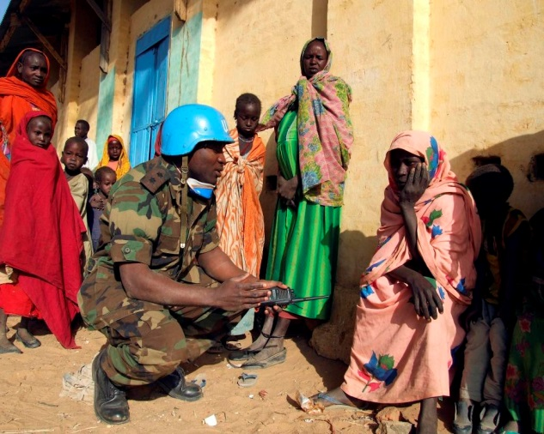
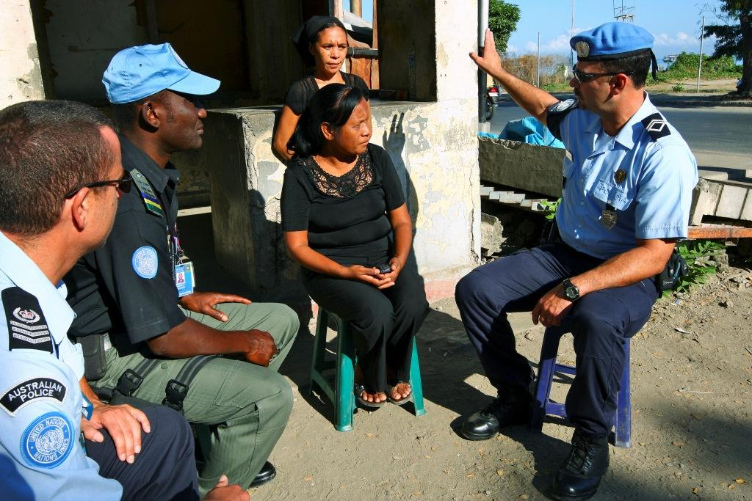
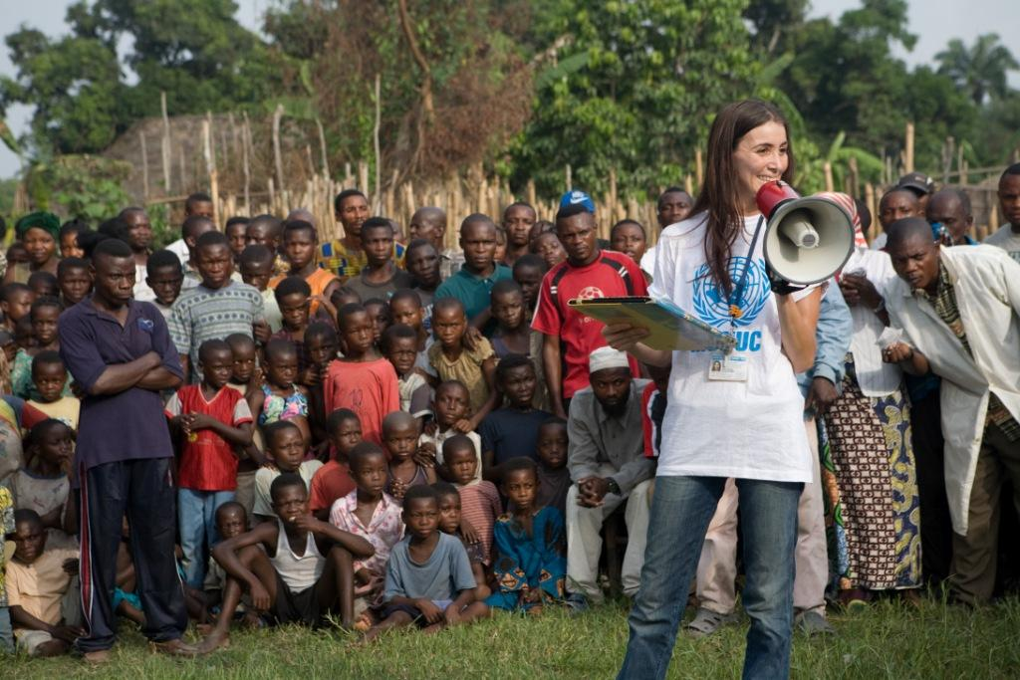
4. UN Security Management System (UNSMS)
Enables conduct of UN activities while ensuring safety, security and wellbeing of personnel, and security of UN premises and assets
UN Core Pre-Deployment Training Materials 2017

Slide 10
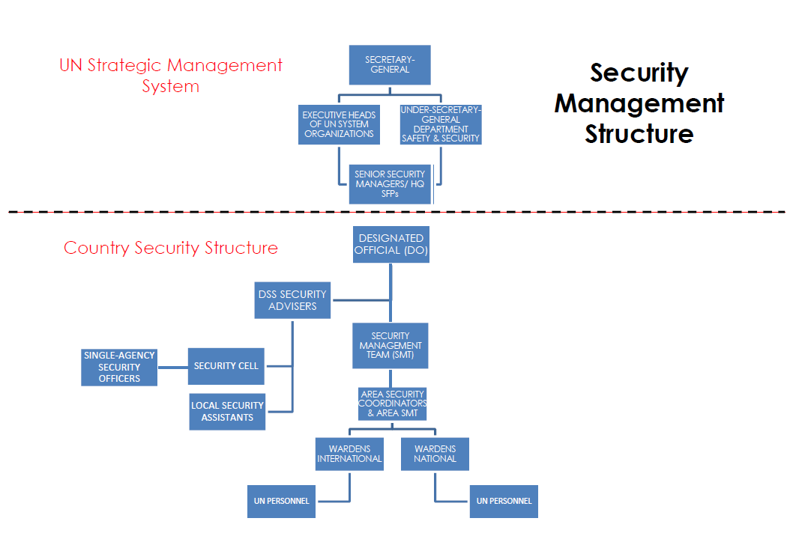
4. UN Security Management System (UNSMS)
UN Core Pre-Deployment Training Materials 2017

Slide 11
5. Security Risk Management (SRM)
Programme Assessment
Threat Assessment
Vulnerability Assessment
Risk Analysis
Options
Decide and Plan
Implement
Review and Modify
UN Core Pre-Deployment Training Materials 2017

Slide 12
6. Security Level System (SLS)
Assigns level of danger
Identifies and measures security threat in specific location
Identifies levels of danger on a scale of 1 to 6 (from lowest to highest)
Focuses on ‘how to stay’ rather than ‘when to go’
6
Extreme
5
High
4
Substantial
3
Moderate
2
Low
1
Minimal
UN Core Pre-Deployment Training Materials 2017

Slide 13
6. Security Level System (SLS)
UN Core Pre-Deployment Training Materials 2017

Slide 14
7. Security Plan
Primary management tool for security preparedness
Describes security measures and arrangements in the event of serious criminality or emergency situations such as hostilities, internal disorder or natural disasters
UN Core Pre-Deployment Training Materials 2017

Slide 15
Learning Activity
3.6.2
Emergency Preparedness – The Run Bag
Instructions:
Imagine there is an emergency situation
What items would be useful for you to have ready in a ”run bag” for survival and evacuation?
Time: 5 minutes
Brainstorming: 3 minutes
Discussion: 2 minutes
UN Core Pre-Deployment Training Materials 2017
Notes:
CPTM 3.5.2

Slide 16
7. Security Plan
UN Core Pre-Deployment Training Materials 2017

Slide 17
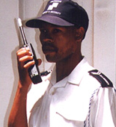
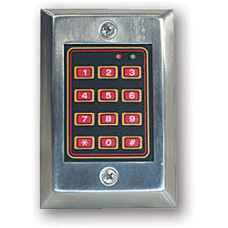
8. MOSS & MORSS
Minimum
Operating
Security
Standards
Minimum
Operating
Residential
Security
Standards
UN Core Pre-Deployment Training Materials 2017

Slide 18
9. Travel Request Information Process (TRIP)
Allows personnel to process mandatory security clearances online
Security clearance is required to know your whereabouts, and provide information and assistance in an emergency
UN Core Pre-Deployment Training Materials 2017

Slide 19
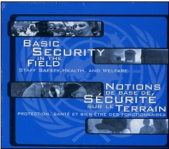
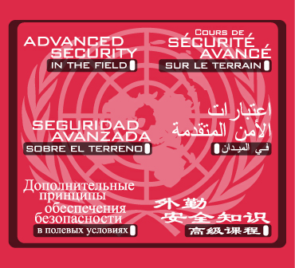
10. What Individual Peacekeeping Personnel Can Do
Abide by the security policies, guidelines, directives, plans, procedures of UNSMS
Basic Security in the Field (BSITF)
Advanced Security in the Field (ASITF)
https://dss.un.org
UN Core Pre-Deployment Training Materials 2017

Slide 20
Learning Activity
3.6.3
Security Arrangements
Instructions:
You are an Area Security Coordinator
Consider the scenario
Identify the risks to UN personnel
List actions to improve security and preparedness
What would you do in the event of violence?
Time: 15 minutes
Group work: 5-7 minutes
Discussion: 5-7 minutes
UN Core Pre-Deployment Training Materials 2017
Notes:
John Otte

Slide 21
Summary of Key Messages
Categories of threats to UN – armed conflict, terrorism, crime, civil unrest, hazards
Responsibility for safety and security – host government, UNSMS, yourself
Security Level System (SLS) – identifies threat or danger in an area
Travel Request Information Process (TRIP) – online mandatory security clearance for travel
UN Core Pre-Deployment Training Materials 2017

Slide 22
Questions
UN Core Pre-Deployment Training Materials 2017

Slide 23
Learning Activity
Learning Evaluation
UN Core Pre-Deployment Training Materials 2017

